Slide 1


Student Performance Analysis (EDA Project)
SIC – AI 701
Notes:
Note:
1

Slide 2
Agenda
Motivation & Problem
Dataset
Methodology
Findings & Insights
Dashboard
Conclusion
Recommendations
Samsung Innovation Campus

Slide 3
Motivation & Problem
Samsung Innovation Campus
Notes:
Note:
2

Slide 4


Motivation & Problem
Why do some students perform better than others?
Which factors influence scores the most?
Samsung Innovation Campus

Slide 5
Dataset
Samsung Innovation Campus
Notes:
Note:
2

Slide 6
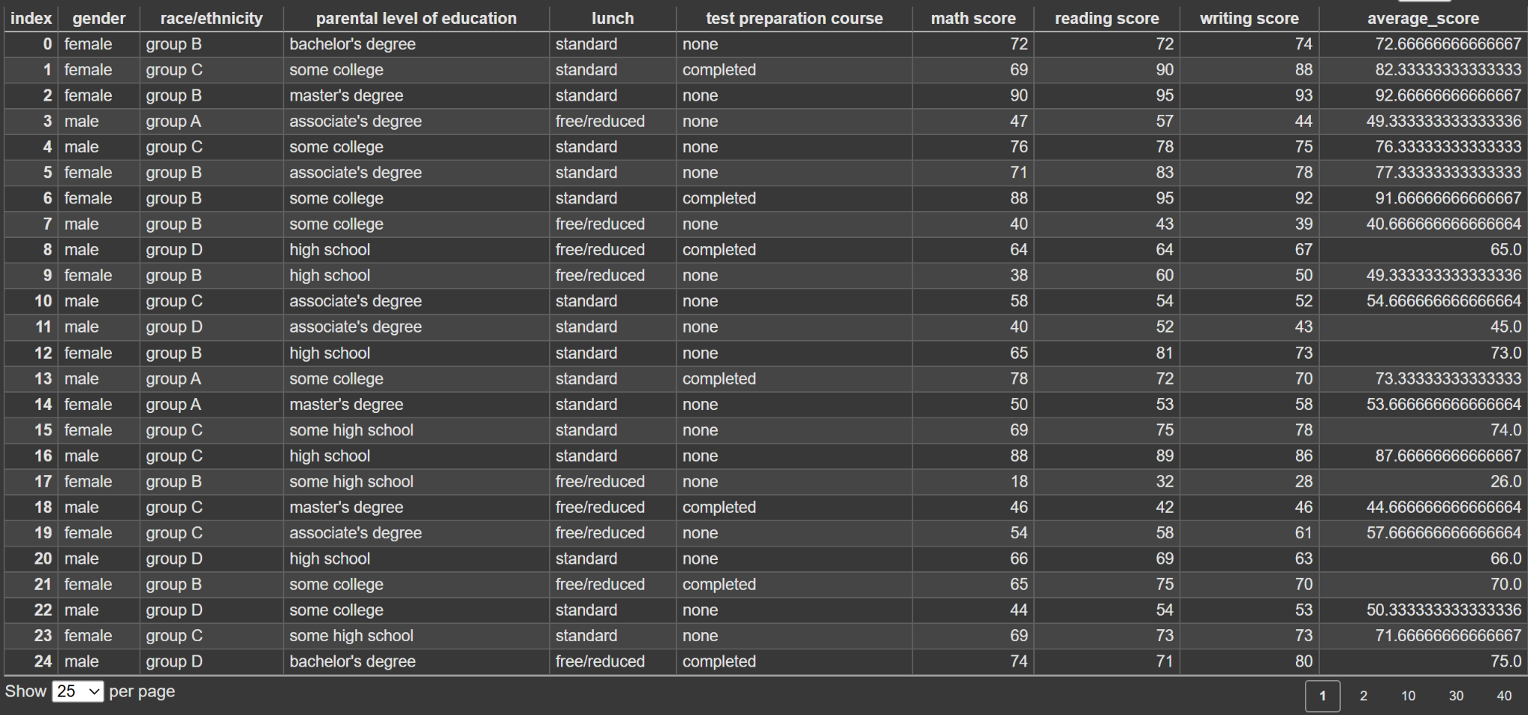
Dataset
1000 students, 8 features (5 categorical, 3 numerical).
Samsung Innovation Campus

Slide 7
Methodology
Samsung Innovation Campus
Notes:
Note:
2

Slide 8
Methodology
1. Data Understanding
Loaded dataset (1000 students, 8 features)
Checked structure, summary statistics, and categorical distributions
2. Data Cleaning
No missing values or duplicates
Outliers detected in scores → handled using capping
3. Feature Engineering
Created new KPI: Average Score = mean of Math, Reading, Writing
One-hot encoded categorical variables: Gender, Lunch, Test Prep, Race/Ethnicity
Label encoded Parental Education into ordered levels
4. Data Exploration & Visualization
Histograms + KDE → score distributions
Scatterplots → relationships between subjects
Boxplots → outlier detection
Grouped bar charts → comparison by categorical factors
5. Statistical Testing
Applied ANOVA to measure significance of group differences:
Lunch type
Test preparation
Parental education
6. Insights Extraction
Visualized average scores by Gender, Lunch, Parental Education, Test Prep, Race/Ethnicity
Identified key performance drivers

Slide 9
Findings & Insights
Samsung Innovation Campus
Notes:
Note:
2

Slide 10
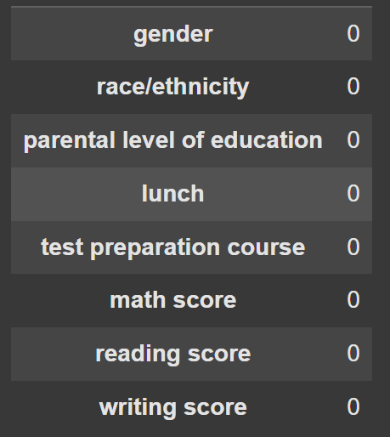
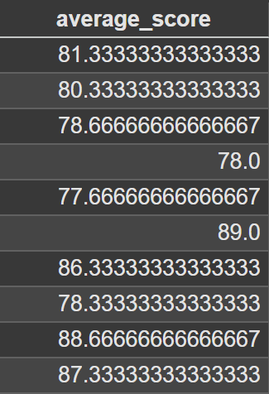
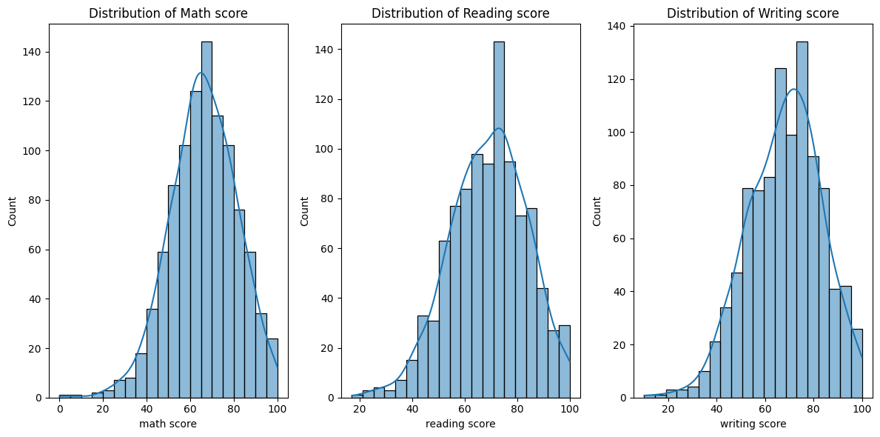
Findings & Insights
Dataset & Preparation
Dataset is clean → no missing values, no duplicates.
Created new KPI: Average Score = mean of math, reading, writing.
Distributions
Math, Reading, and Writing scores are roughly bell-shaped.
Most students score between 50–80.
Samsung Innovation Campus

Slide 11
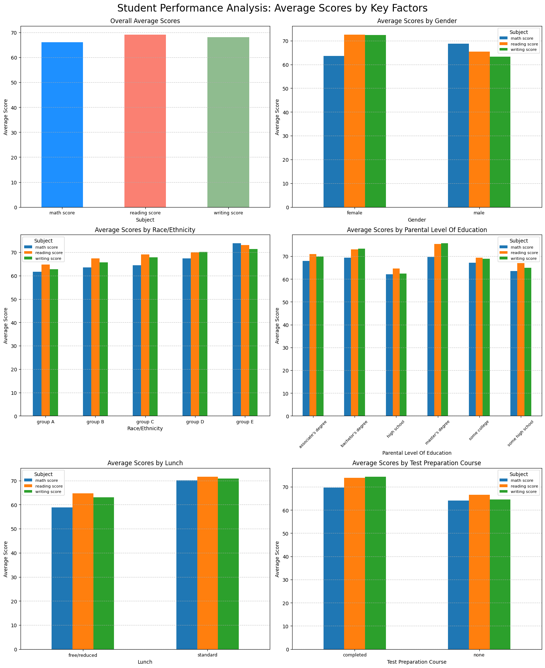
Findings & Insights
Student Performance Analysis

Slide 12
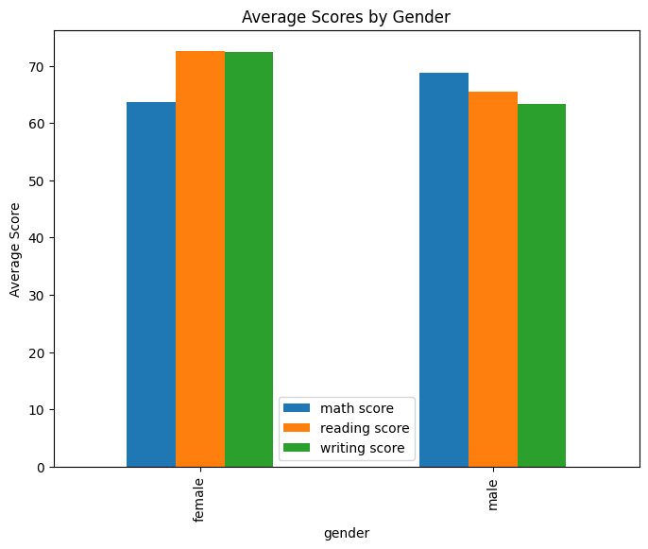
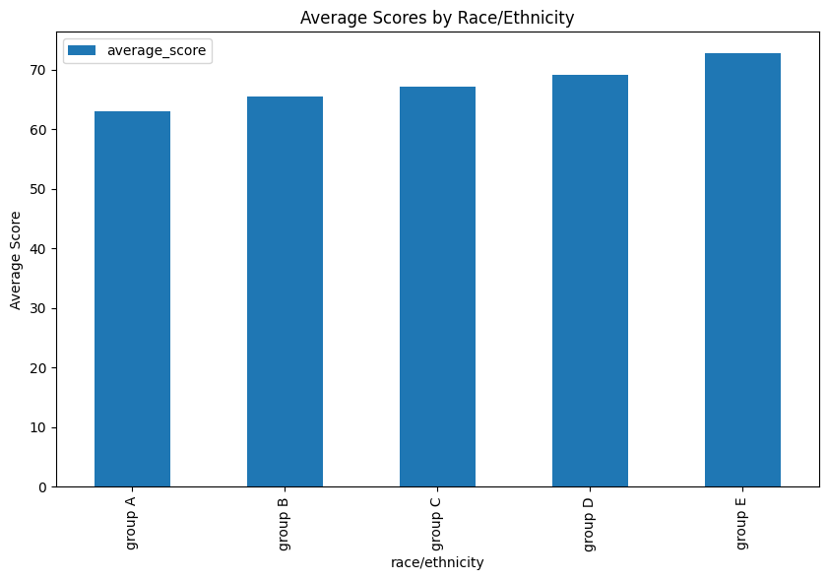
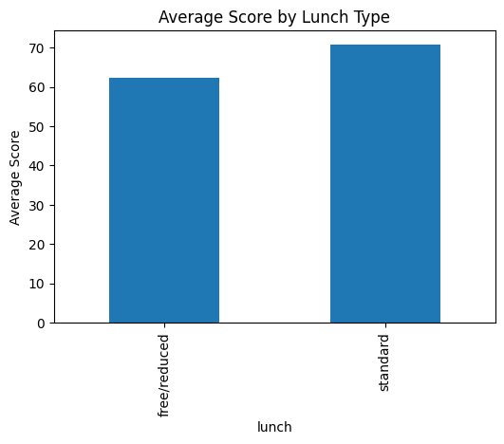
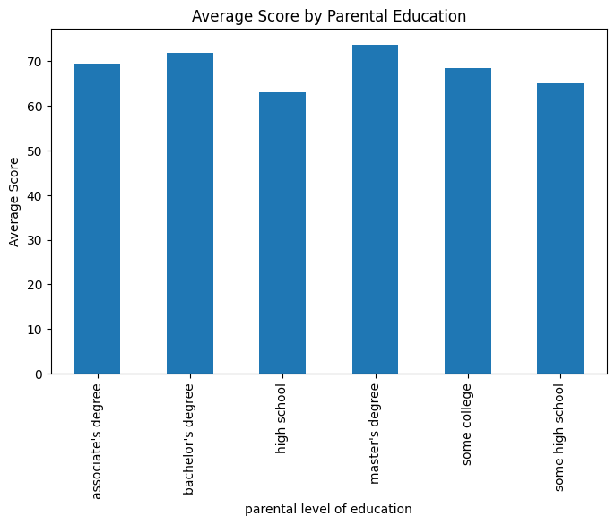
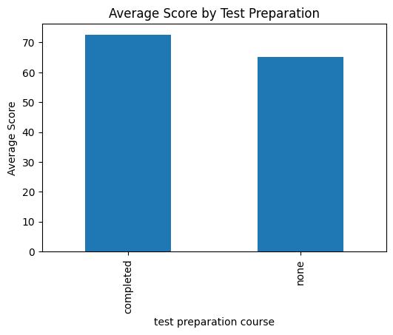
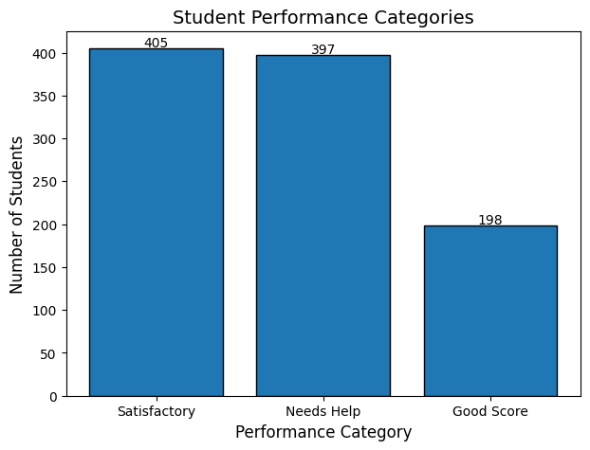
Findings
Race/Ethnicity
Lunch Type
Gender
Parental Education
Test Preparation
Performance Category

Slide 13
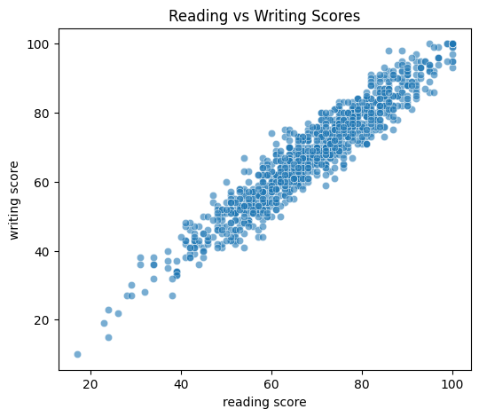
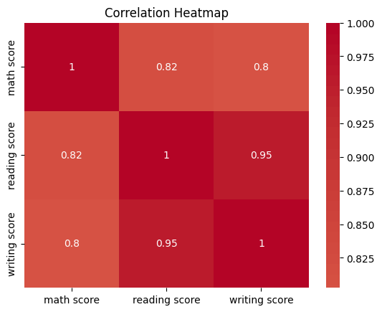
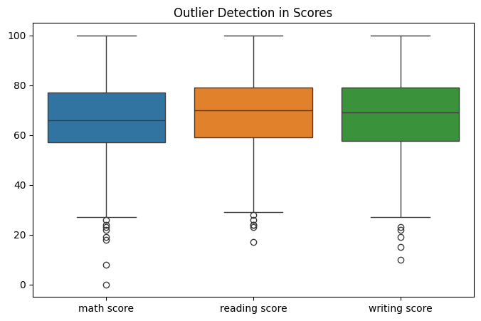
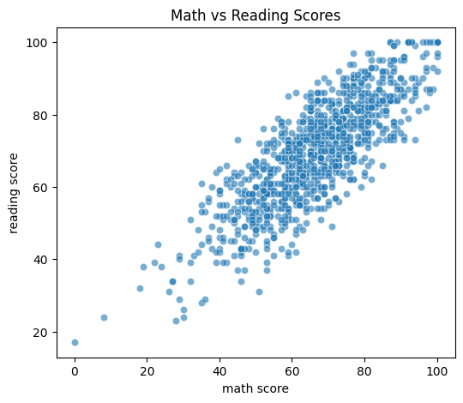
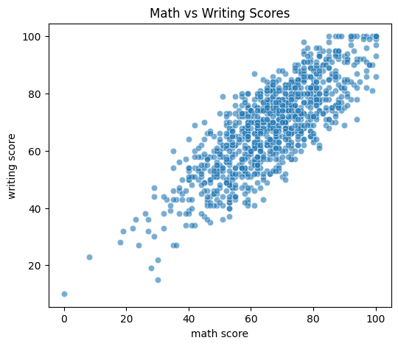
Findings & Insights
Relationships
Reading & Writing: Very strong positive correlation.
Math vs Reading/Writing: Also positively correlated but slightly weaker.
Outliers
Some students scored far below the median in math, reading, and writing.
No extreme outliers after capping → extreme low values were adjusted to reduce skew and avoid distortion.
Samsung Innovation Campus

Slide 14
Findings & Insights
Score Comparison Results
(On Average)
Lunch → Free/reduced: 12% less
Economic background affects performance.
Test Prep → Completed: +12%
Prep courses boost scores significantly.
Parental Education → High vs Low: +17%
Higher parental education supports better outcomes.
Group Differences (ANOVA results)
1) Lunch Effect
Result: F = 91.68, p ≪ 0.05
Insight: Students with better lunch perform significantly higher.
Conclusion: Nutrition strongly impacts academic performance.
2) Test Preparation Effect
Result: F = 70.41, p ≪ 0.05
Insight: Students who completed test prep scored much higher.
Conclusion: Preparation courses are highly effective.
3) Parental Education Effect
Result: F ≈ 0, p = 1.0
Insight: No significant difference in scores by parental education.
Conclusion: Student effort & support matter more than parent’s education level.
Samsung Innovation Campus

Slide 15
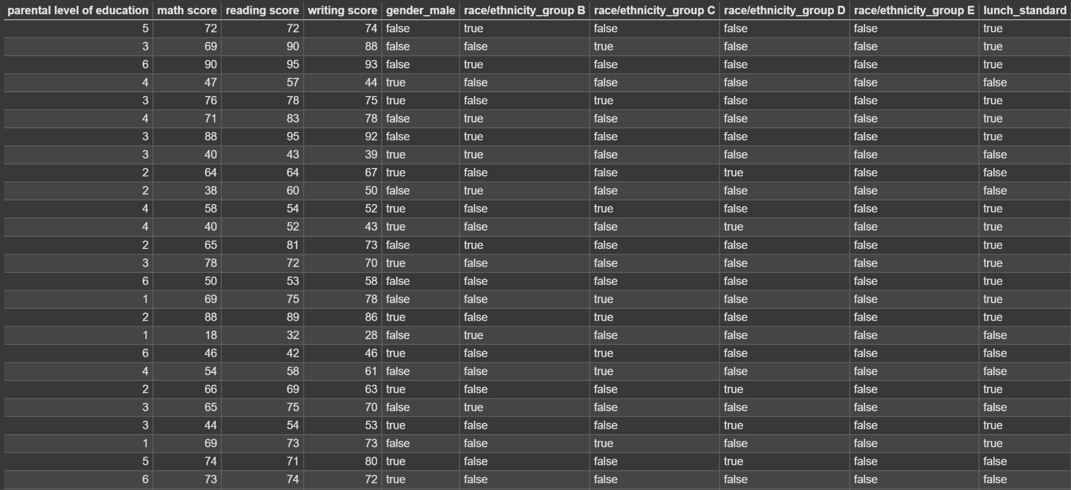
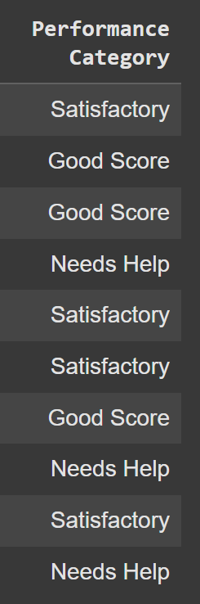
New Dataset

Slide 16
Dashboard
Samsung Innovation Campus
Notes:
Note:
2

Slide 17
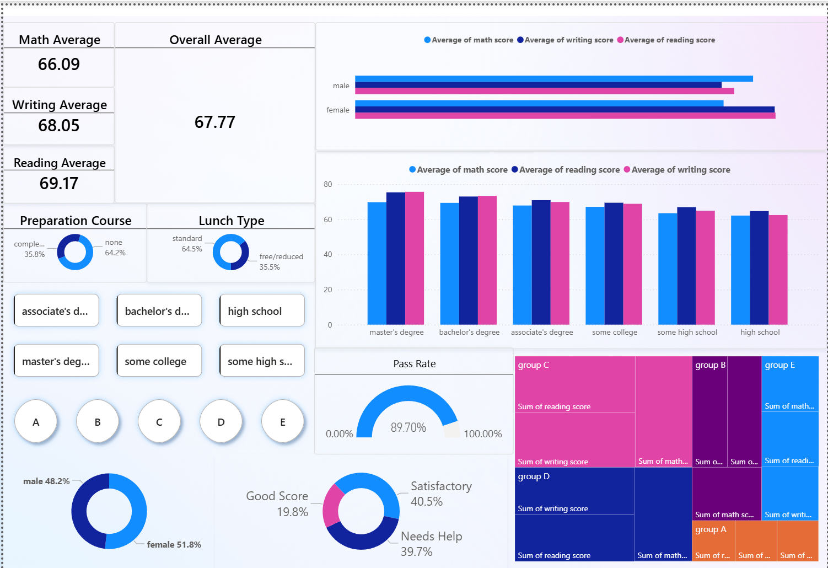
Dashboard

Slide 18
Conclusion
Samsung Innovation Campus
Notes:
Note:
2

Slide 19
Conclusions
Student Performance and Targeted Support
Approximately 31% of the students fall into the "Needs Help" category, indicating they scored below 60 in at least one subject. This group represents a critical target for academic intervention and support programs.
Parental Background and Student Achievement :
There is a clear relationship between parental education and student scores.students whose parents have higher degrees consistently scored higher on average across all three subjects compared to those whose parents had less formal education
The average score difference between students whose parents had the highest level of education and those with the lowest was 16.64%.

Slide 20
Conclusions
Test Preparation is Highly Effective
Completing a test preparation course has a significant and positive impact on student scores. The visualizations and statistical tests confirm that students who completed the course consistently outperformed those who did not.
Students who completed the course scored, on average, 11.73% higher.
Socio-Economic Factors Matter
The data reveals a significant link between a student's performance and their socioeconomic background. The type of lunch a student receives serves as a direct indicator of their financial circumstances
The analysis consistently shows that students with a standard lunch scored higher across all subjects compared to their peers who received a free or reduced lunch. This finding suggests that a student's socioeconomic status is a key factor influencing their academic performance.

Slide 21
Conclusions
Gender-Based Performance Differences
The data shows a clear and significant difference in performance between genders :
Male students, on average, performed better in math.
Female students, on average, performed better in both reading and writing.
Ethnic and Racial Group Differences
A visual comparison of the average scores by ethnic group shows a clear trend in student performance :-
Students in Group E consistently achieved the highest average scores across all three subjects (math, reading, and writing).
Conversely, students in Group A generally recorded the lowest average scores in all subjects.
The average scores for the other groups (B, C, and D) fall somewhere between these two extremes. While the chart shows that average scores appear to vary across the groups

Slide 22
Recommendations
Samsung Innovation Campus
Notes:
Note:
2

Slide 23
Recommendations
Implement a Targeted Academic Support Program for students
The program could be designed to focus on specific subjects, Based on their results in this certain subject
Expand the Test Preparation Course
Given that a large portion of students (64%) did not take this course, a recommendation is to expand its availability. The school should actively encourage more students to enroll, particularly those who are identified as needing help regarding their financial condition
Address Socio-Economic Disparities
The school should explore initiatives to ensure that students from lower-income backgrounds have access to the resources they need to succeed academically.
This could include providing additional tutoring, school supplies, or after-school programs that address potential resource gaps.

Slide 24
Recommendations
Offer Subject-Specific Support
The school could offer specialized workshops or clubs for students who may be underperforming in a specific subject.
For example, a "Math for Girls" club or a "Literacy for Boys" program could be implemented to address these specific needs and help close the performance gaps.
Notes:
`

Slide 25
Questions and Discussion
Samsung Innovation Campus
Notes:
Note:
2

Slide 26

ⓒ2020 SAMSUNG. All rights reserved.
Samsung Electronics Corporate Citizenship Office holds the copyright of book.
This book is a literary property protected by copyright law so reprint and reproduction without permission are prohibited.
To use this book other than the curriculum of Samsung innovation Campus or to use the entire or part of this book, you must receive written consent from copyright holder.
Notes:
14

